Slide 1


Slide 2

The Widest Wisdom
Understanding the Christian Doctrine of Creation
Christopher Baglow, Ph.D.
McGrath Institute for Church Life
University of Notre Dame

Slide 3

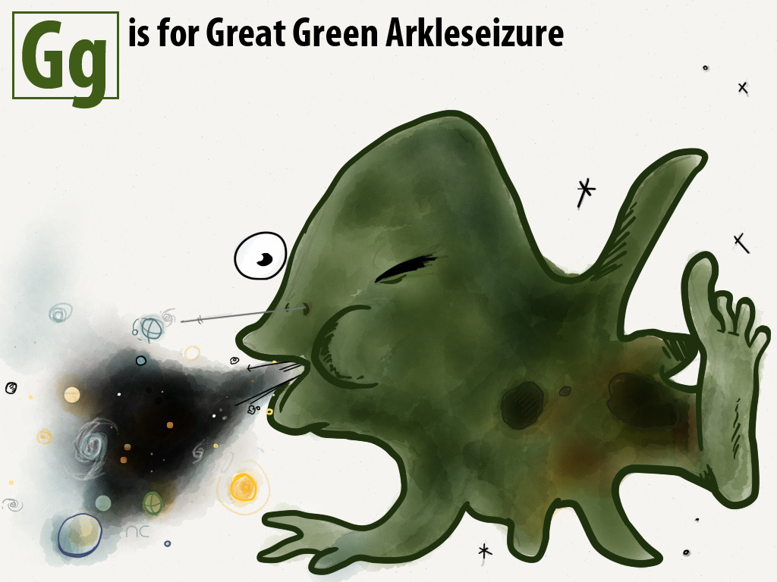

Slide 4

A Jatravartid Specimen

Slide 5
Defeating Jatravartid Sneezeology:
Creation out of nothing
Creation with time
Creation with freedom
Creation by the Trinity

Slide 6
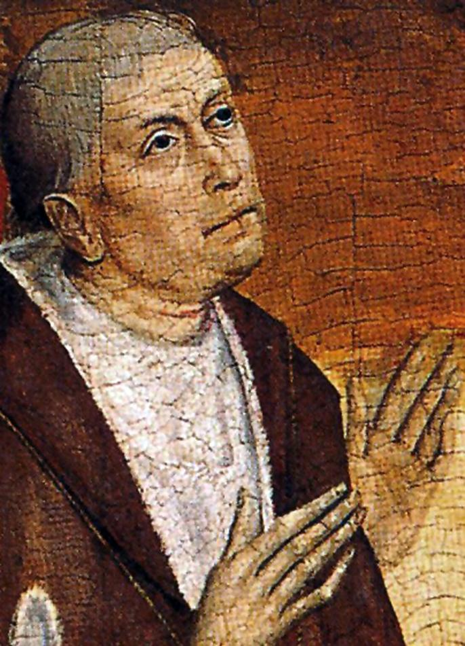
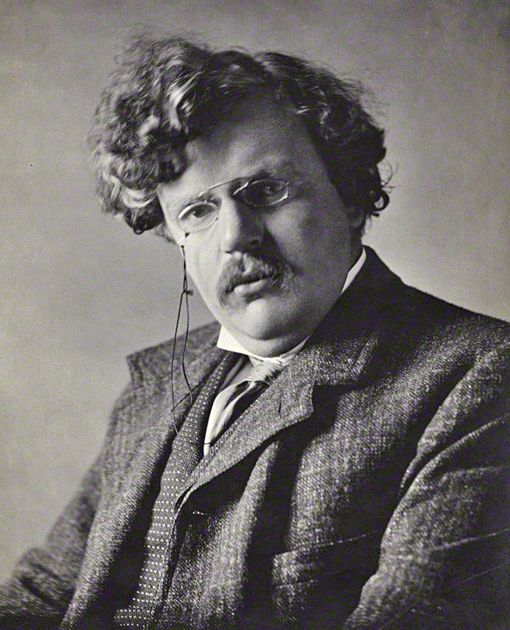
Nicholas of Cusa
G.K. Chesterton

Slide 7
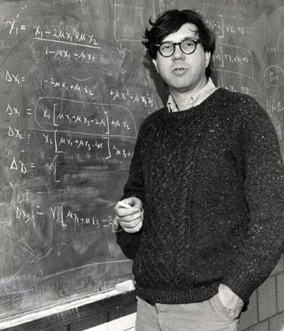
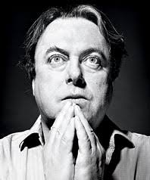
Richard Lewontin
Christopher Hitchens

Slide 8
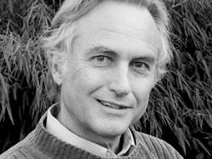
“…the Genesis story is just one that happened to have been adopted by one particular tribe of Middle Eastern herders. It has no more special status than the belief of a particular West African tribe that the world was created from the excrement of ants.”
-Richard Dawkins

Slide 9
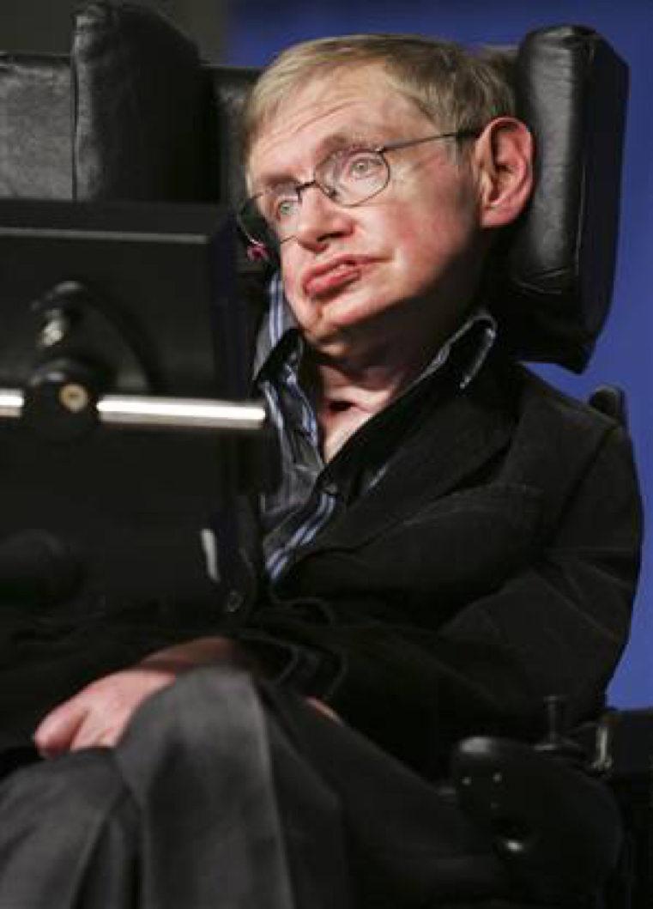
“So when people ask me if a god created the universe, I tell them the question itself makes no sense. Time didn’t exist before the Big Bang, so there is no time for God to make the universe in.”
-Stephen Hawking

Slide 10
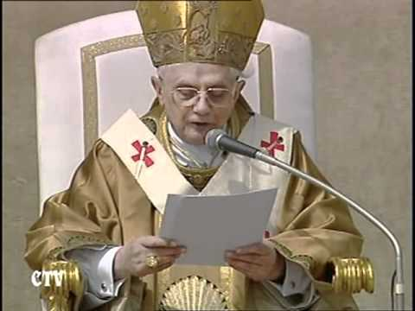
“We are not some casual and meaningless product of evolution. Each of us is the result of a thought of God. Each of us is willed. Each of us is loved. Each of us is necessary.”
-Benedict XVI

Slide 11
The Implications of Creation
Cum Libertate
God is free to create or not to create
God is not forced to create the “best possible universe”
The “best possible universe” is a concept without content
The act of creation is perfect; the actual creation is not

Slide 12
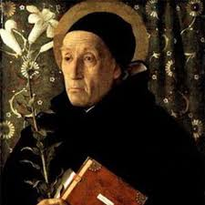
“In the core of the Trinity the Father laughs and gives birth to the Son. The Son laughs back at the Father and gives birth to the Spirit. The whole Trinity laughs and gives birth to us.”
-Meister Eckhart

Slide 13
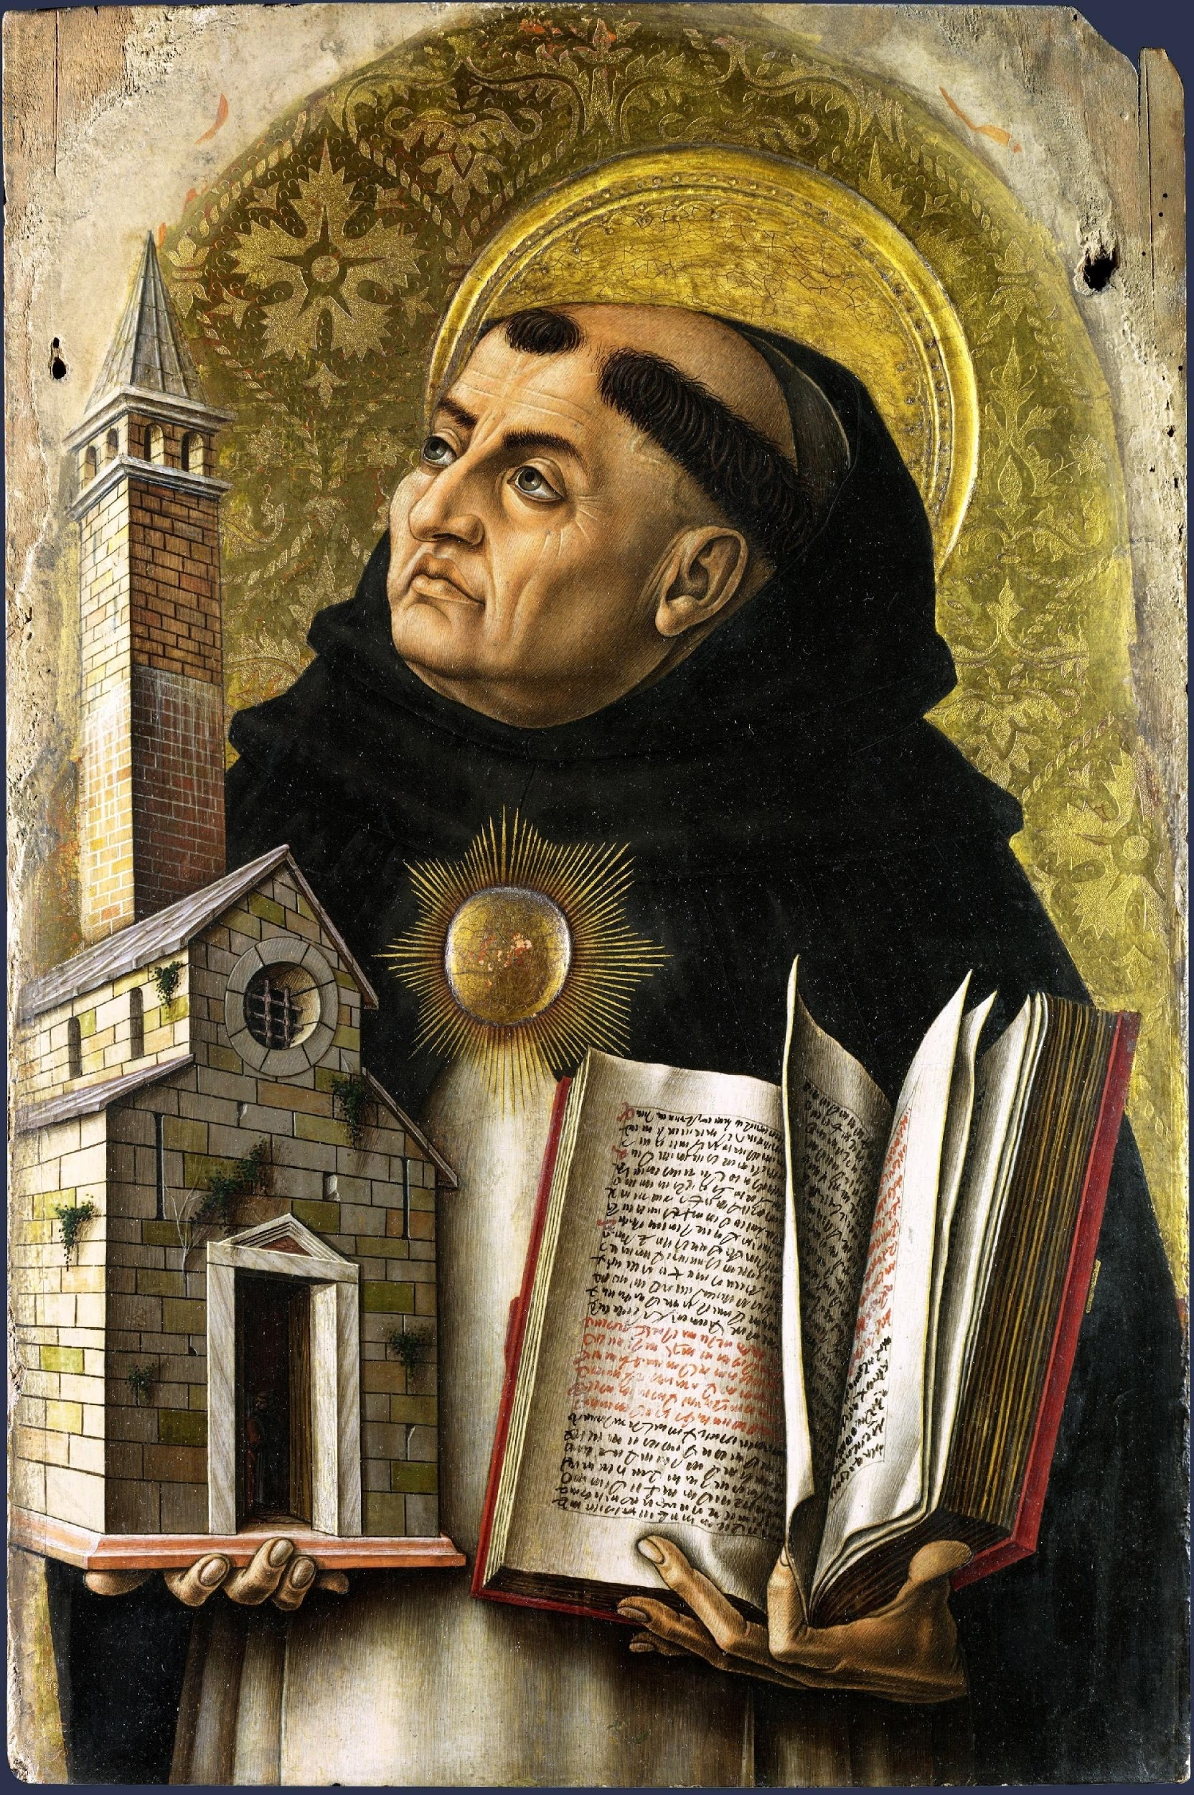
“When a person’s love is caused by the goodness of the one he loves, then that person loves out of justice—it is just that he love such a person. When, however, love causes goodness in the beloved, then it is a love springing from mercy. The love with which God loves us produces goodness in us; hence mercy is… the root of divine love…”
-St. Thomas Aquinas, In Eph. 2.2
Creation ex Trinitate

Slide 15


